Slide 1
File Allocation on Disk
Low level access methods for a file depend upon the disk allocation scheme used to store file data
  Contiguous
  Linked list
  Block or indexed

Slide 2
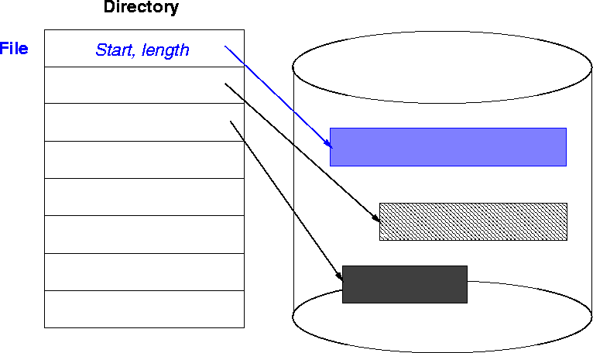
#1. Contiguous Allocation

Slide 3
Contiguous Allocation
Access method suits sequential and direct access
Directory table maps files into starting physical address and length
Easy to recover in event of system crash
Fast, often requires no head movement and when it does, head only moves one track

Slide 4
Contiguous Allocation Issues
File is allocated large contiguous chunks
Expanding the file requires copying
Dynamic storage allocation - first fit, best fit
External fragmentation occurs on disk

Slide 5
External Fragmentation
Solution: Linked allocation

Slide 6
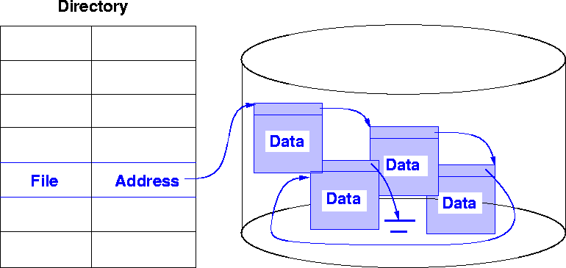
#2. Linked Allocation

Slide 7
Linked List Allocation
Each file is a linked list of nodes
Pointers in list are not accessible to user
Directory table maps files into head of list for a file
A node in the list can be a fixed size physical block or a contiguous collection of blocks
Easy to use - no estimation of size necessary

Slide 8
Linked List Allocation
Can grow in middle and at ends
Space efficient, little fragmentation
Slow - defies the principle of locality. Need to read through linked list of nodes sequentially to find the needed blocks of data
Suited for sequential access but not direct access

Slide 9
Linked List Allocation Issues
Disk space must be used to store pointers (if disk block is 512 bytes, and disk address requires 4 bytes, then the user sees blocks of 508 bytes)
Not very reliable. System crashes can scramble files being updated

Slide 10
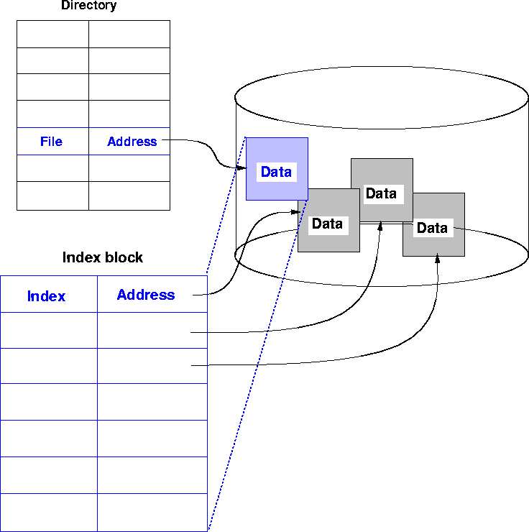
#3. Indexed Allocation

Slide 11
Indexed Allocation
Solves external fragmentation
Supports sequential, direct and indexed access
Access requires at most one access to index block first. This can be cached in main memory

Slide 12
Indexed Allocation
Requires extra space for index block, possible wasted space
How to extend to big files?
  A file can be extended by using linked indexed files or multilevel indexed files

Slide 13
Overview of Mass Storage Structure
Magnetic disks provide bulk of secondary storage of modern computers
  Drives rotate at 60 to 250 times per second
  Transfer rate is rate at which data flow between drive and computer
  Positioning time (random-access time) is time to move disk arm to desired cylinder (seek time) and time for desired sector to rotate under the disk head (rotational latency)
  Head crash results from disk head making contact with the disk surface -- That’s bad
Disks can be removable
Drive attached to computer via I/O bus
  Host controller in computer uses bus to talk to disk controller built into drive or storage array

Slide 14

Moving-head Disk Mechanism

Slide 15
Disk Scheduling
The operating system is responsible for using hardware efficiently — for the disk drives, this means having a fast access time and disk bandwidth
Minimize seek time
Seek time ≈ seek distance
Disk bandwidth is the total number of bytes transferred, divided by the total time between the first request for service and the completion of the last transfer

Slide 16
Disk Scheduling (Cont.)
There are many sources of disk I/O request
  OS
  System processes
  Users processes
I/O request includes input or output mode, disk address, memory address, number of sectors to transfer
OS maintains queue of requests, per disk or device
Idle disk can immediately work on I/O request, busy disk means work must queue
  Optimization algorithms only make sense when a queue exists

Slide 17
Disk Scheduling (Cont.)
Note that drive controllers have small buffers and can manage a queue of I/O requests (of varying “depth”)
Several algorithms exist to schedule the servicing of disk I/O requests
The analysis is true for one or many platters
We illustrate scheduling algorithms with a request queue (0-199)
98, 183, 37, 122, 14, 124, 65, 67
Head pointer 53

Slide 18

FCFS
Illustration shows total head movement of 640 cylinders

Slide 19

SSTF
Shortest Seek Time First selects the request with the minimum seek time from the current head position
SSTF scheduling is a form of SJF scheduling; may cause starvation of some requests
Illustration shows total head movement of 236 cylinders

Slide 20
SCAN
The disk arm starts at one end of the disk, and moves toward the other end, servicing requests until it gets to the other end of the disk, where the head movement is reversed and servicing continues.
SCAN algorithm Sometimes called the elevator algorithm
Illustration shows total head movement of 236 cylinders
But note that if requests are uniformly dense, largest density at other end of disk and those wait the longest

Slide 21

SCAN (Cont.)

Slide 22
C-SCAN
Provides a more uniform wait time than SCAN
The head moves from one end of the disk to the other, servicing requests as it goes
  When it reaches the other end, however, it immediately returns to the beginning of the disk, without servicing any requests on the return trip
Treats the cylinders as a circular list that wraps around from the last cylinder to the first one
Total number of cylinders?

Slide 23

C-SCAN (Cont.)

Slide 24
C-LOOK
LOOK a version of SCAN, C-LOOK a version of C-SCAN
Arm only goes as far as the last request in each direction, then reverses direction immediately, without first going all the way to the end of the disk
Total number of cylinders?

Slide 25

C-LOOK (Cont.)

Slide 26
Selecting a Disk-Scheduling Algorithm
SSTF is common and has a natural appeal
SCAN and C-SCAN perform better for systems that place a heavy load on the disk
  Less starvation
Performance depends on the number and types of requests
Requests for disk service can be influenced by the file-allocation method
  And metadata layout
The disk-scheduling algorithm should be written as a separate module of the operating system, allowing it to be replaced with a different algorithm if necessary
Either SSTF or LOOK is a reasonable choice for the default algorithm
What about rotational latency?
  Difficult for OS to calculate
How does disk-based queueing effect OS queue ordering efforts?

